Slide 1


Slide 2
House Rules for Today’s Site Visit
Everyone
  Find appropriate Zoom links in agenda
    Website: https://leap.research.columbia.edu/
    Username: NSF
    Password: LEAP
    Different rooms throughout day
    Back-Up Plan: WebEx link emailed
  Email mb3952@columbia.edu for logistics/ IT support
LEAP Non-Presenters
  Camera off, mic off
  Protect bandwidth
  Only presenters answer questions

Slide 3
Welcome + Director’s Overview

Slide 4

Associate Professor
Earth + Environmental Engineering
Earth + Environmental Sciences, Columbia University
  PhD, Civil + Environmental Engineering, MIT
Expertise
  Hydrologic cycle
  Land-atmosphere interactions
  Machine learning for geoscience
Other Synergistic Experience
  Co-Founder + Co-Lead, Data Science Working Group,
  US CLIVAR
  Co-Lead, NOAA Drought Task Force
  Member, Working Group on Seasonal to Interannual Prediction, World Climate Research Program

Slide 5
My Presentation Will Explain:
Significant societal problems requiring LEAP’s solutions
2. Center vision + integration of all activities
3. Leadership + management strategies promoting an effective culture
4. Role of team personnel + partner organizations

Slide 6

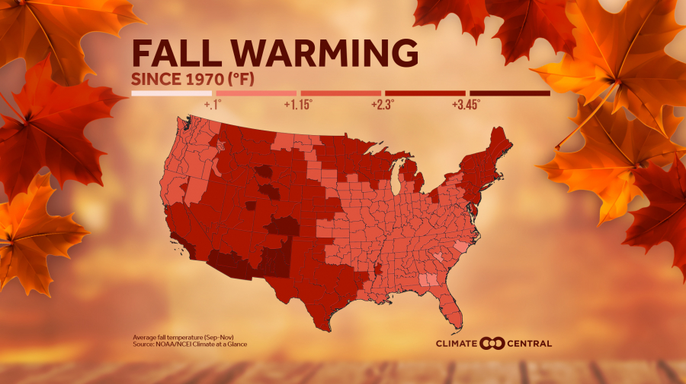
Climate Change is our Grand Challenge
Atmosphere
From 1880 - 2012, average global temperatures increased by 0.85°C
2°C is maximum excess carbon budget
NOAA 2020

Slide 7

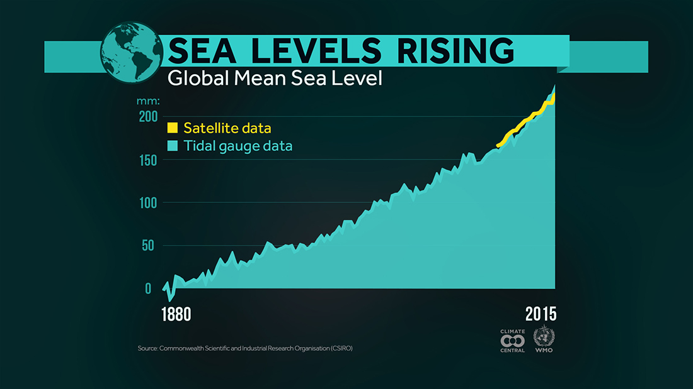
Climate Change is our Grand Challenge
Atmosphere
From 1880 - 2012, average global temperatures increased by 0.85°C
2°C is maximum excess carbon budget
Ocean
Since 1850, global sea levels rose by 19cm
  15cm more by 2031;
  30cm more by 2050
  Sea Walls: $280 - $500B projected annual cost
Commonwealth Scientific + Industrial Research Organization 2020

Slide 8

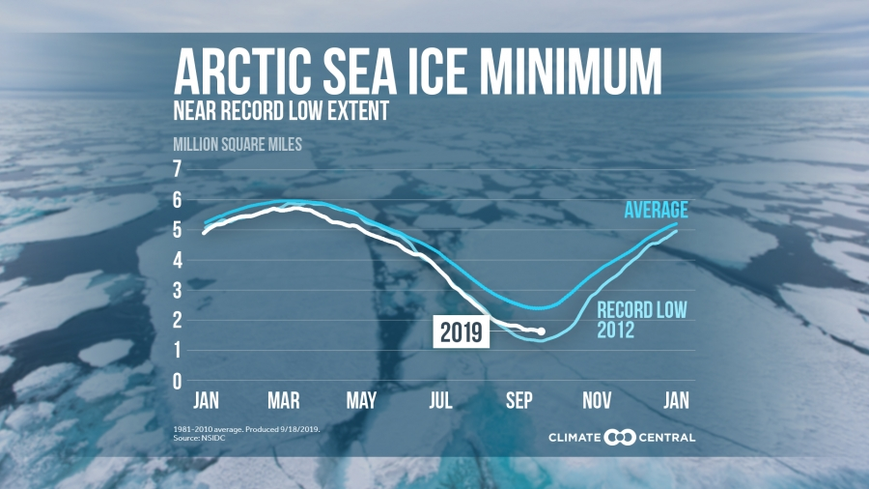
Climate Change is our Grand Challenge
Atmosphere
From 1880 - 2012, average global temperatures increased by 0.85°C
2°C is maximum excess carbon budget
Ocean
Since 1850, global sea levels rose by 19cm
  15cm more by 2031;
  30cm more by 2050
  Sea Walls: $280 - $500B projected annual cost
Cryosphere
Arctic ice sheets are melting
1991 - 2001: 30 Gt/ year
2002 - 2011: 147 Gt/ year
NSDC 2019

Slide 9

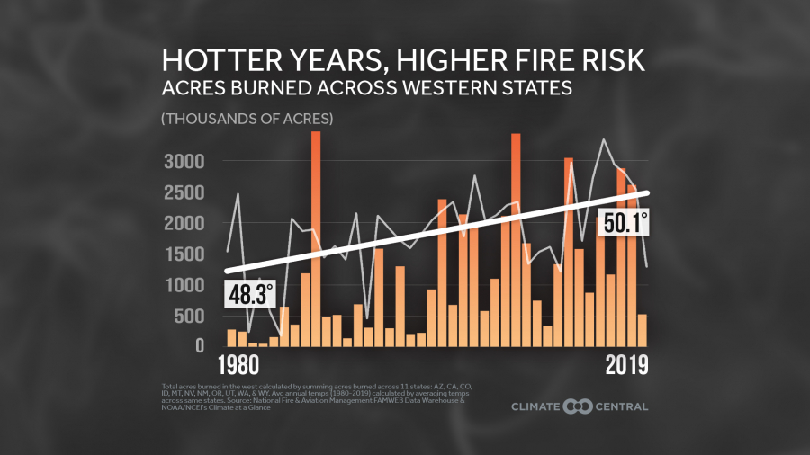
Climate Change is our Grand Challenge
Atmosphere
From 1880 - 2012, average global temperatures increased by 0.85°C
2°C is maximum excess carbon budget
Ocean
Since 1850, global sea levels rose by 19cm
  15cm more by 2031;
  30cm more by 2050
  Sea Walls: $280 - $500B projected annual cost
Cryosphere
Arctic ice sheets are melting
1991 - 2001: 30 Gt/ year
2002 - 2011: 147 Gt/ year
Land
Wildfires + extreme events have increased in frequency
National Fire + Aviation Management FAMWEB Data Warehouse

Slide 10
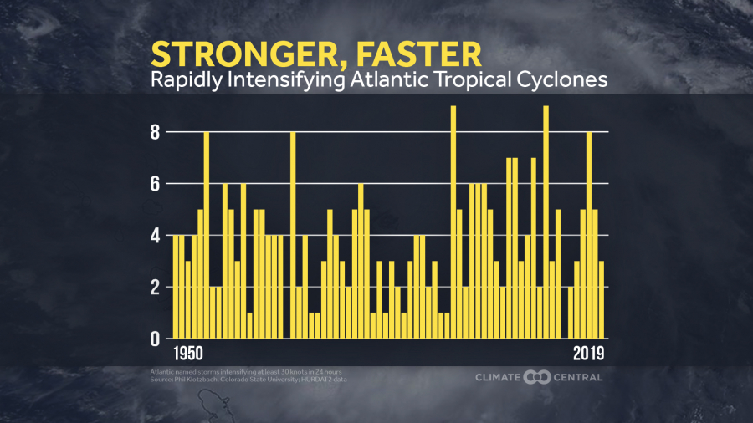
American Lives are Directly and Already Impacted by Climate Change
Klotzbach 2019

Slide 11
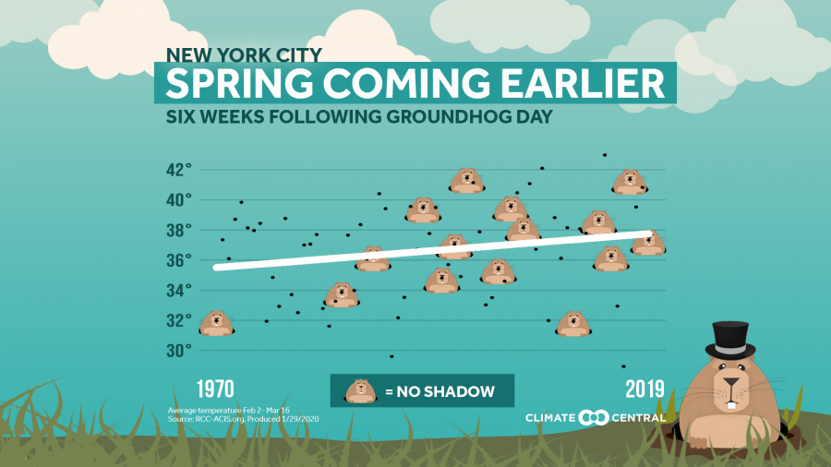
American Lives are Directly and Already Impacted by Climate Change
RCC-ACIS.org, 2020

Slide 12
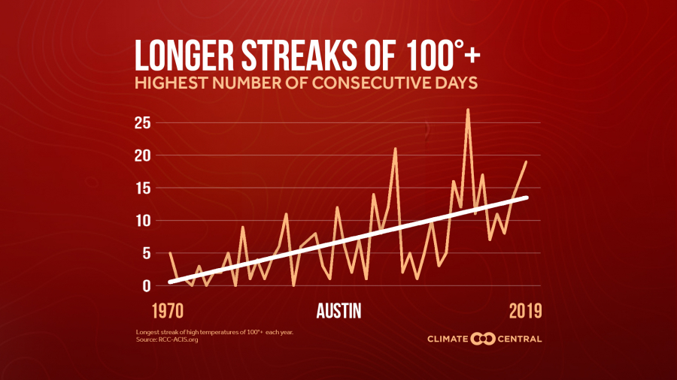
American Lives are Directly and Already Impacted by Climate Change
RCC-ACIS.org, 2020

Slide 13
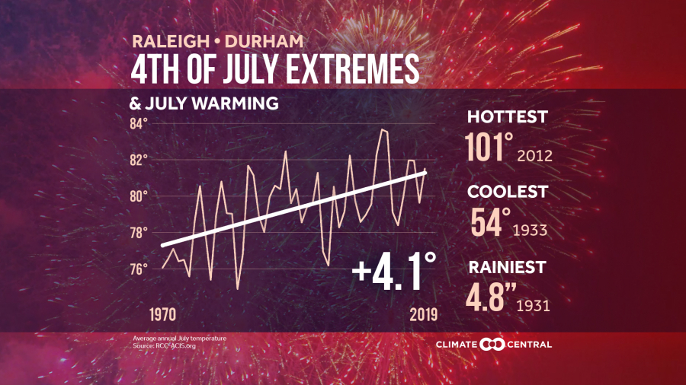
American Lives are Directly and Already Impacted by Climate Change
Ziska 2007

Slide 14
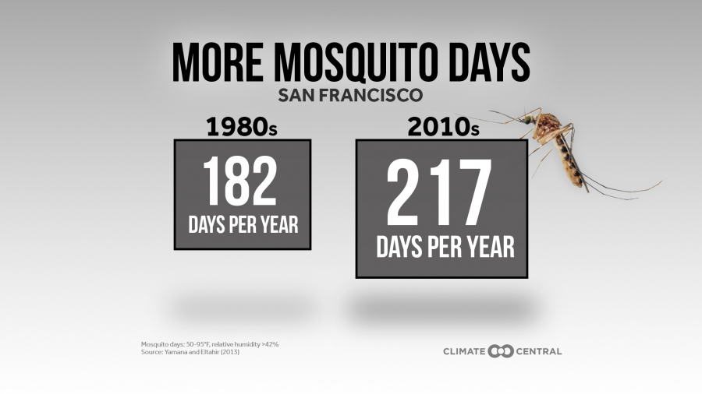
American Lives are Directly and Already Impacted by Climate Change
Yamana + Eltahir 2013

Slide 15
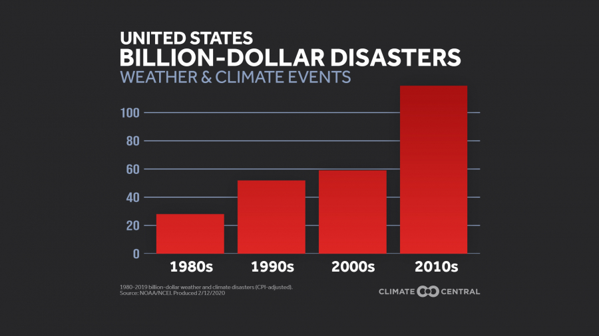
Number of $1B+ Disasters are Irrevocably Increasing
Reduction of future human + financial costs requires adaptation
NOAA 2020

Slide 16
To Promote + Protect:
National Security
Economic Prosperity
Human Health
Environmental Sustainability
We must predict + adapt to climate change now

Slide 17
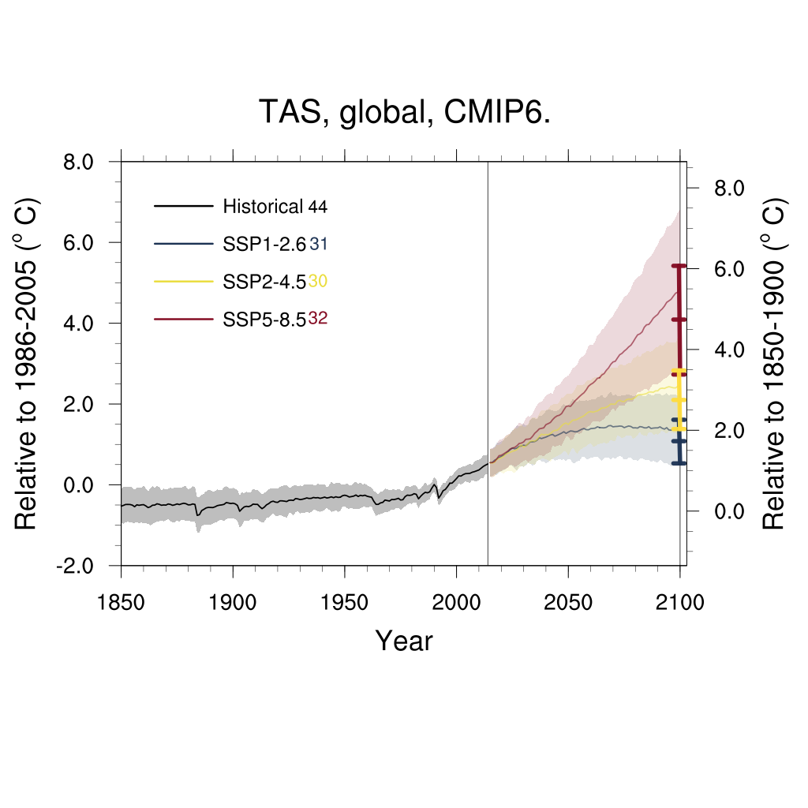
Adaptation Requires Reliable Climate Projections (Forecasts)
Projections made with Earth System Models (ESMs)
Current models are too uncertain
Earth system models do not create actionable adaptation
Global Air Temperature - CMIP6 (New Generation)
Business
as usual
Model Spread
Eyring et al., 2020 in prep.

Slide 18
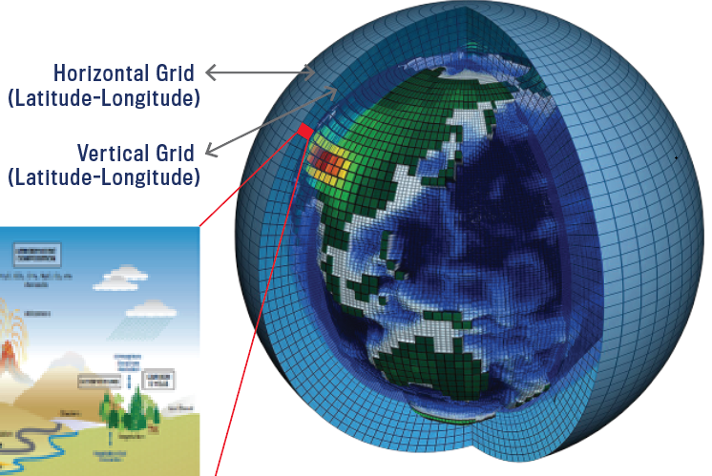
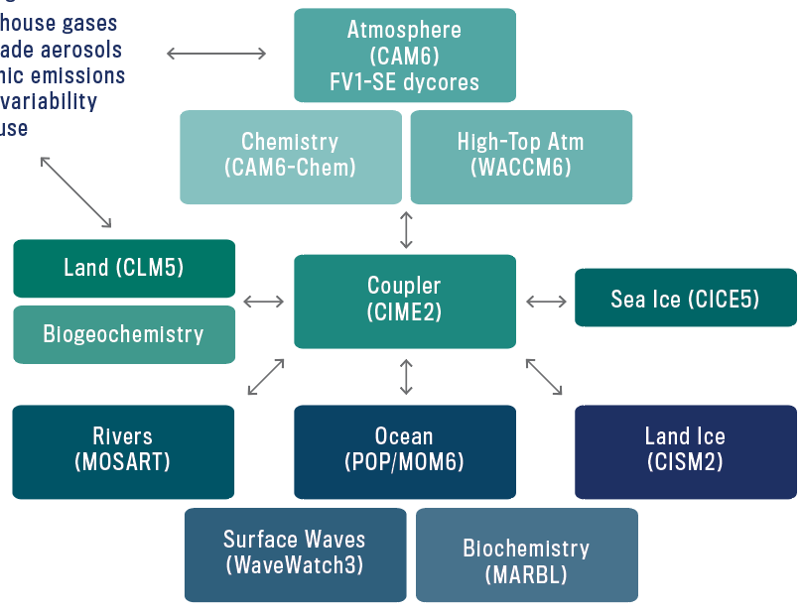
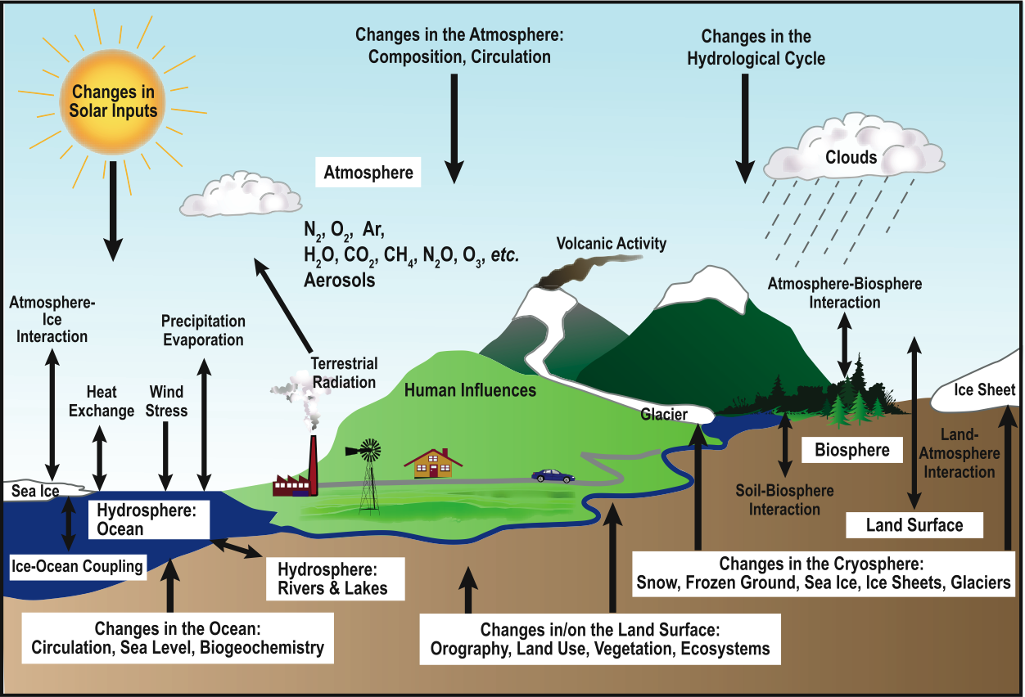
An Earth System Model is a Complex Coupled System
Simplified representation in
Earth System Models (ESMs)
1000’s of equations
Parameters empirically
fine-tuned
Grid resolution ~100km

Slide 19
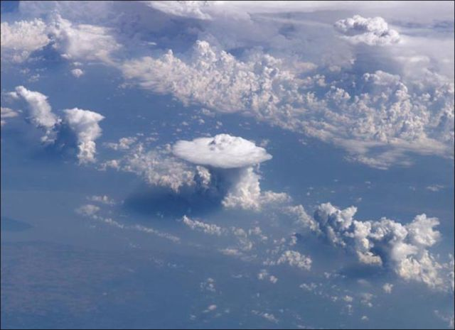
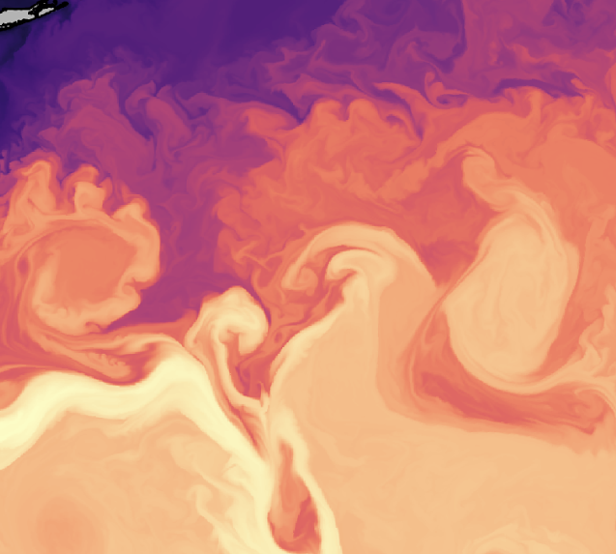
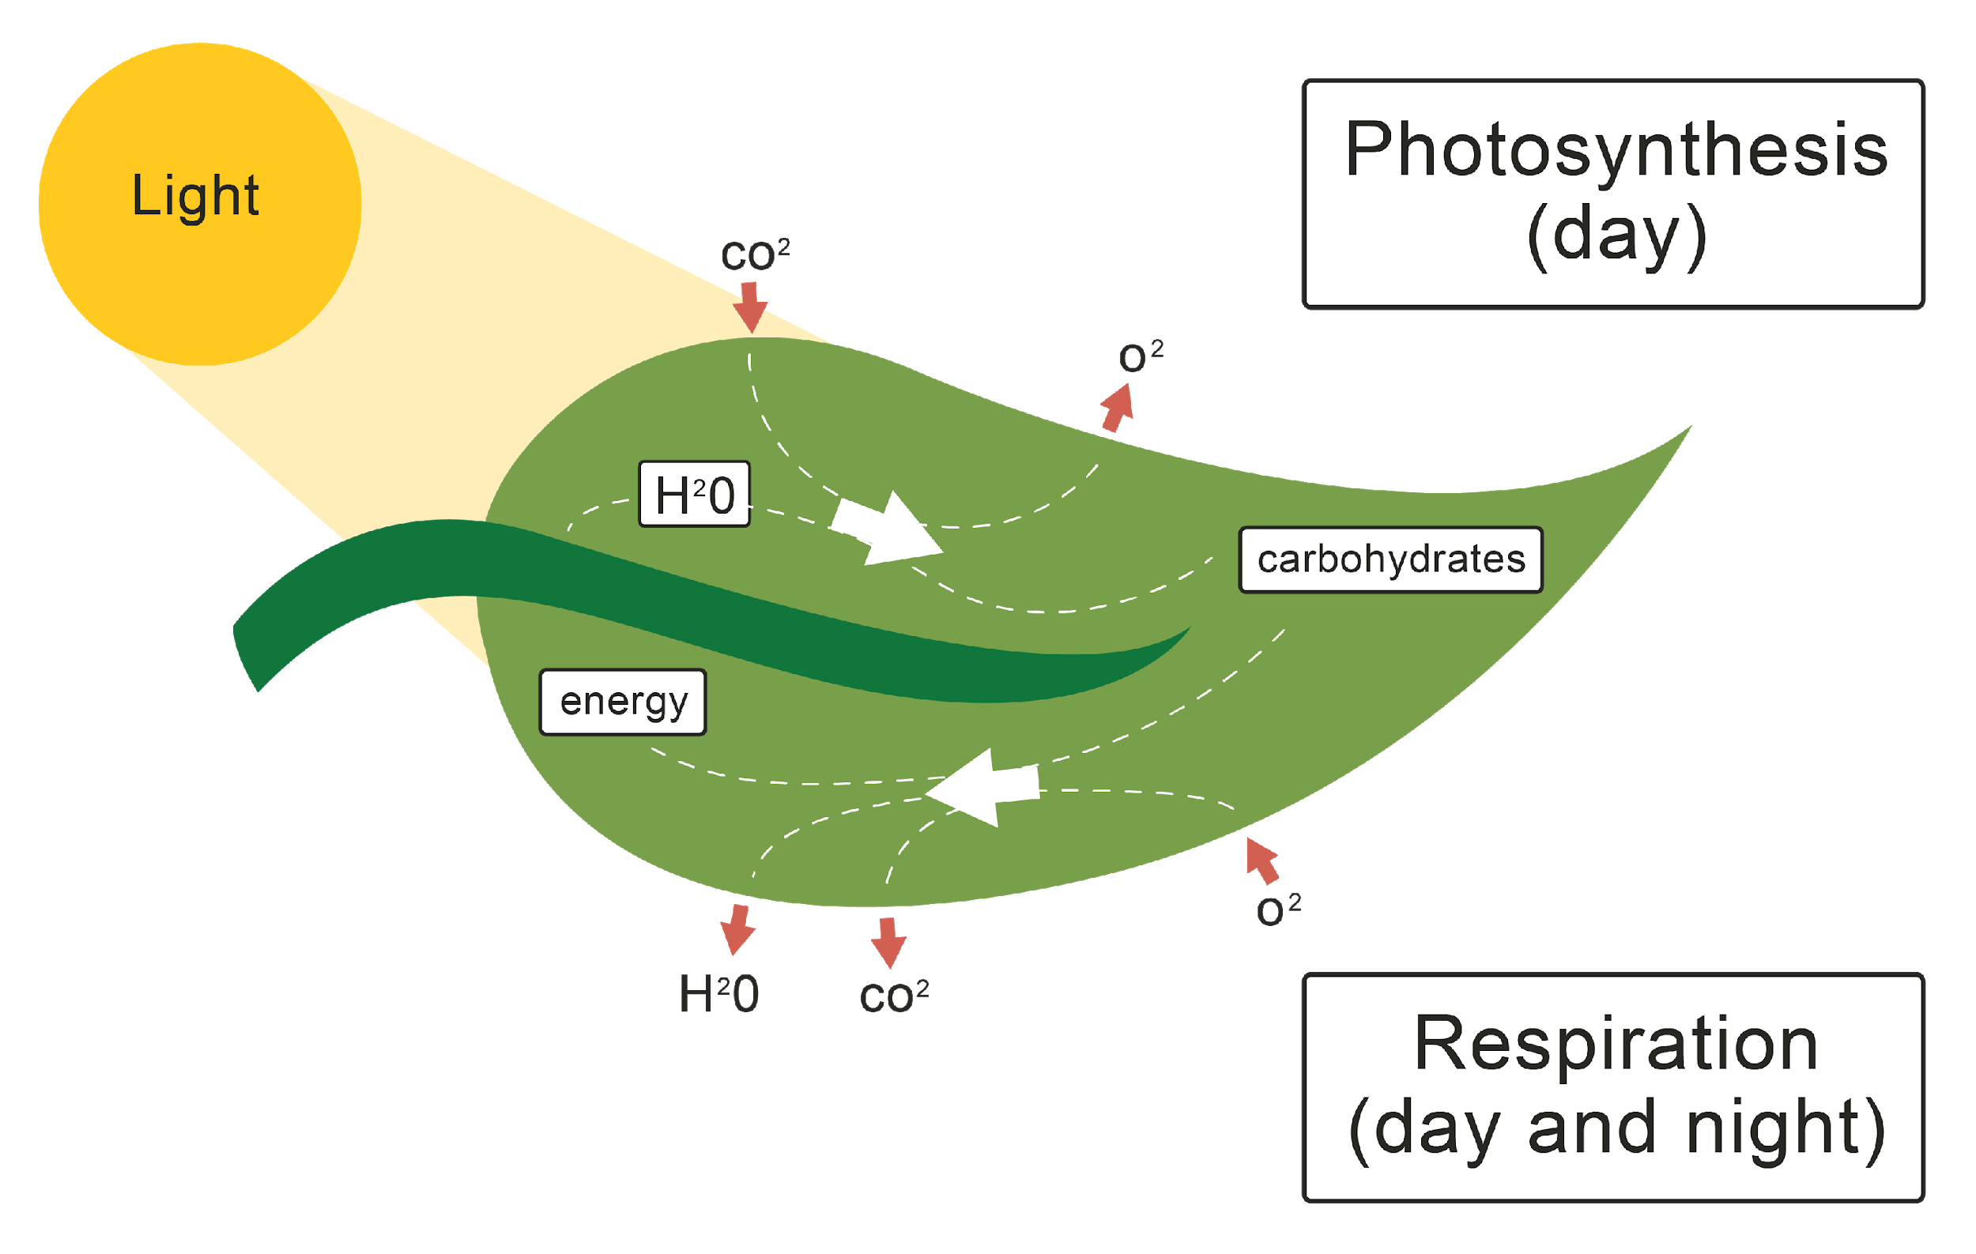
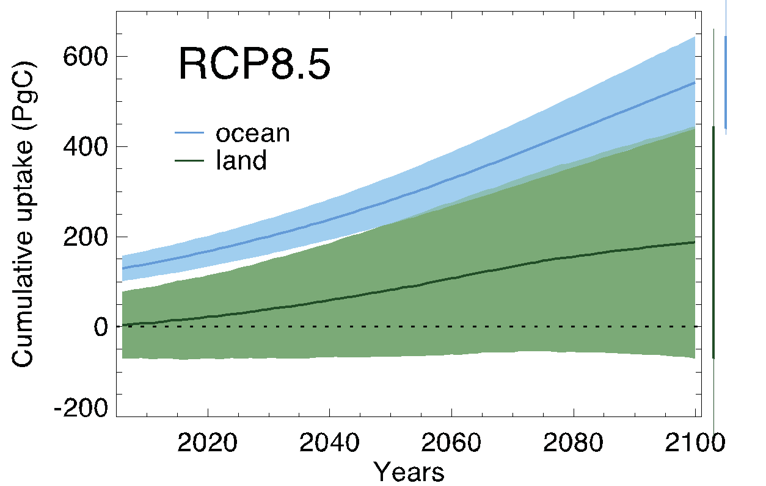
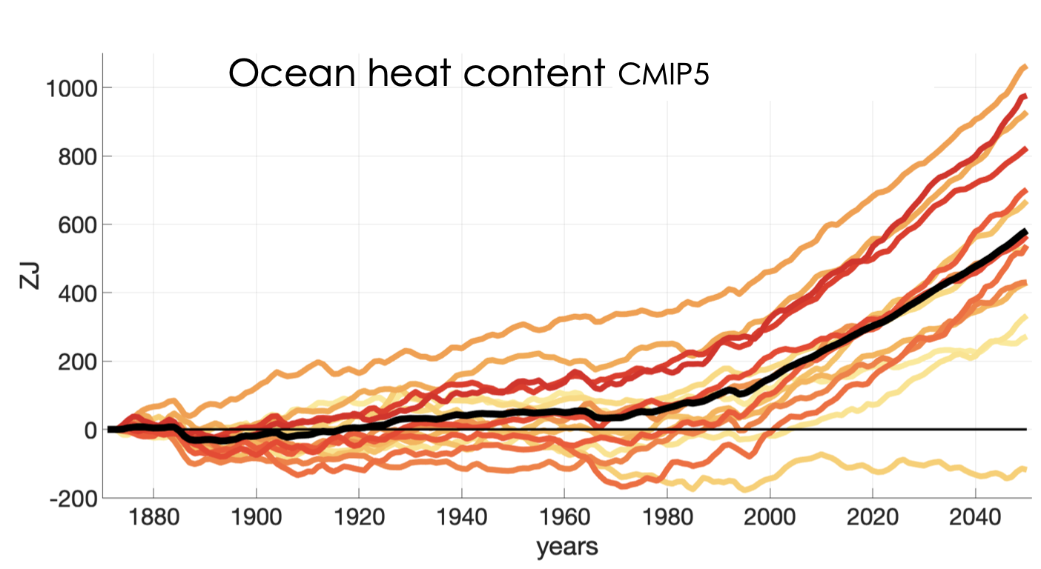
Unresolved Small + Complex Processes Require “Parameterizations” Causing Projection Uncertainties
Clouds
Ocean Eddies
Photosynthesis
Physical
+ Biological Processes
ESM Grid ~100km
~100km
Model errors dominate (>50%) uncertainties <40 years
Massive amount of data to constrain those processes
Newsom, Zanna et al., 2020 Geo Res Letters; Bronselaer + Zanna, 2020 Nature; Friedlingstein et al. 2006 J Climate

Slide 20


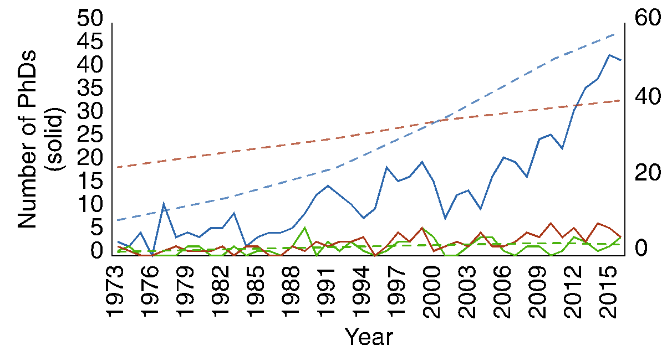
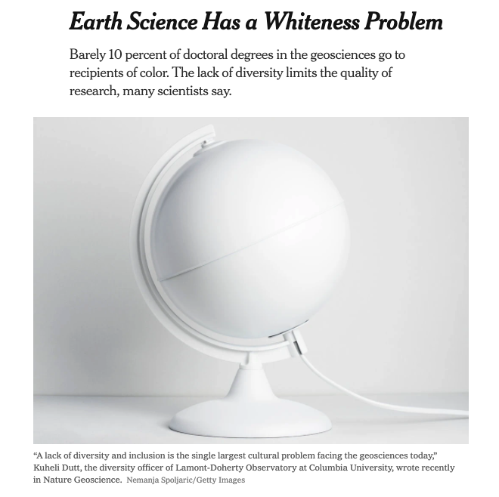
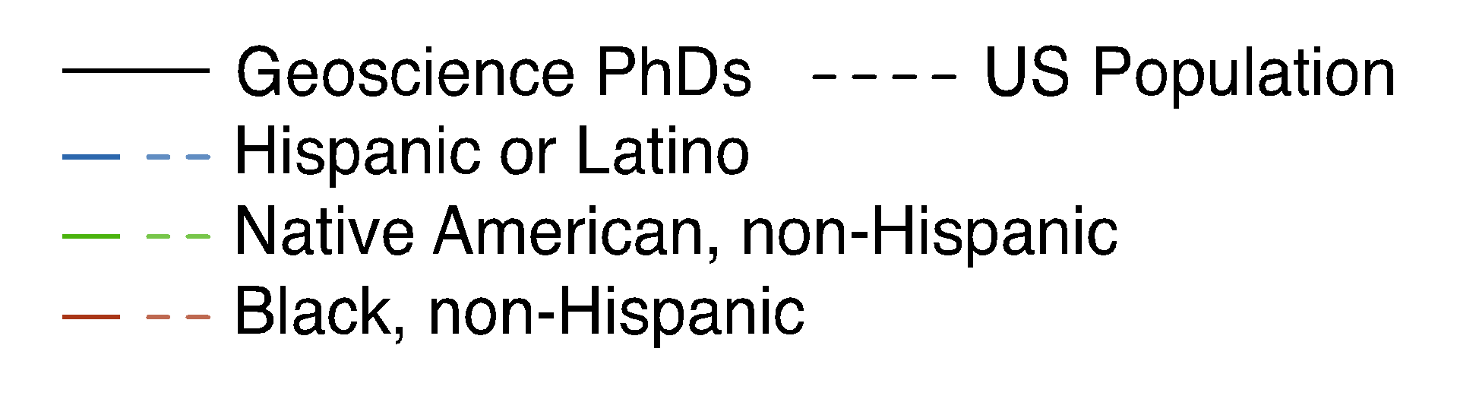
Other Biases: Lack of Diversity Handicaps
Reach + Utility of Climate Modeling
Climate science has made progress in gender equity, but is still not racially/ ethnically diverse
  Columbia’s ADVANCE grant established best practices
Yet, climate change disproportionately impacts underrepresented minorities
Bernard + Cooperdock 2018 Nature Geo; Dutt 2020 Nature Geo

Slide 21
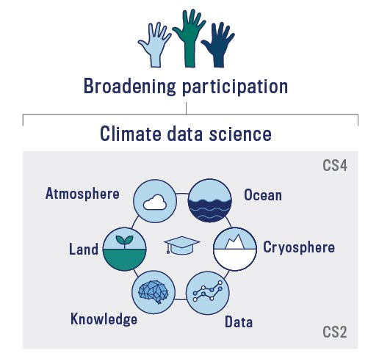
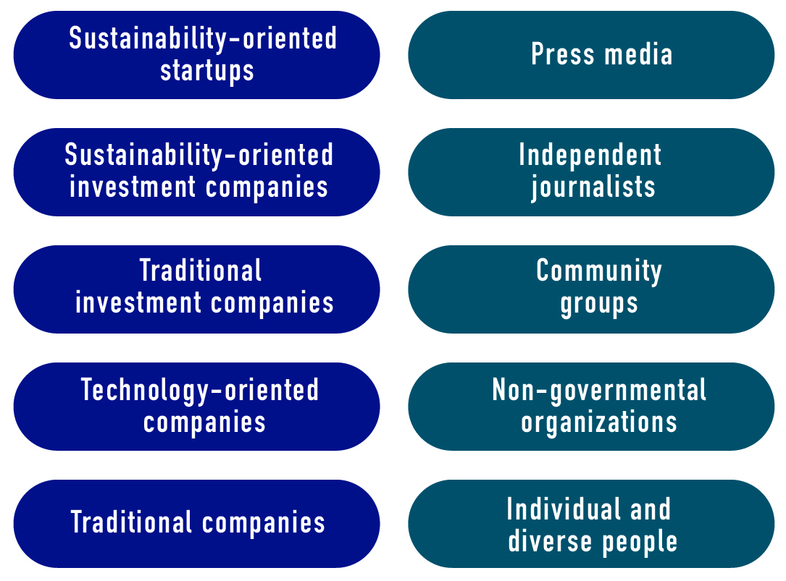
Other Biases: Climate Communications are One-Way
Data is not formatted/ available for accessibility + actionable knowledge
Researchers have limited understanding of public + private stakeholders’ concerns
Decision-makers need dialogue + actionable information to adapt
Climate Data Science Research
Imprecise Projections
Stakeholders

Slide 22
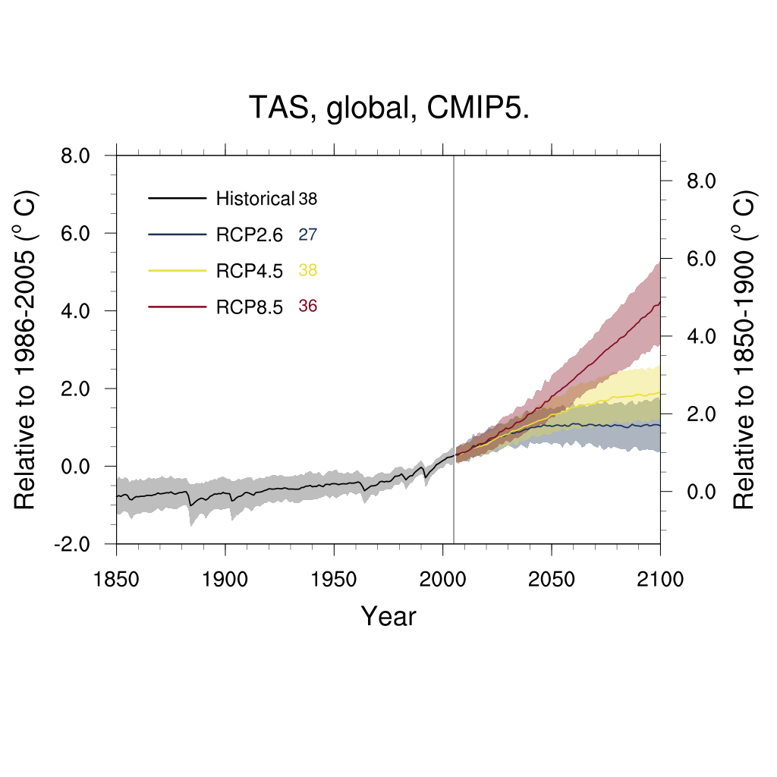
Time is Running Out to Adapt
ESM parameterization progress is too slow
  On par with climate change
Diversity + inclusion + communication progress is equally slow
Reliable climate models need an inclusive STEM workforce + broad stakeholder engagement for national progress
Global Air Temperature – CMIP5 (Earlier Generation)
Global Air Temperature – CMIP6 (New Generation)
Model Spread
Model Spread
Randall et al., 2003, BAMS

Slide 23
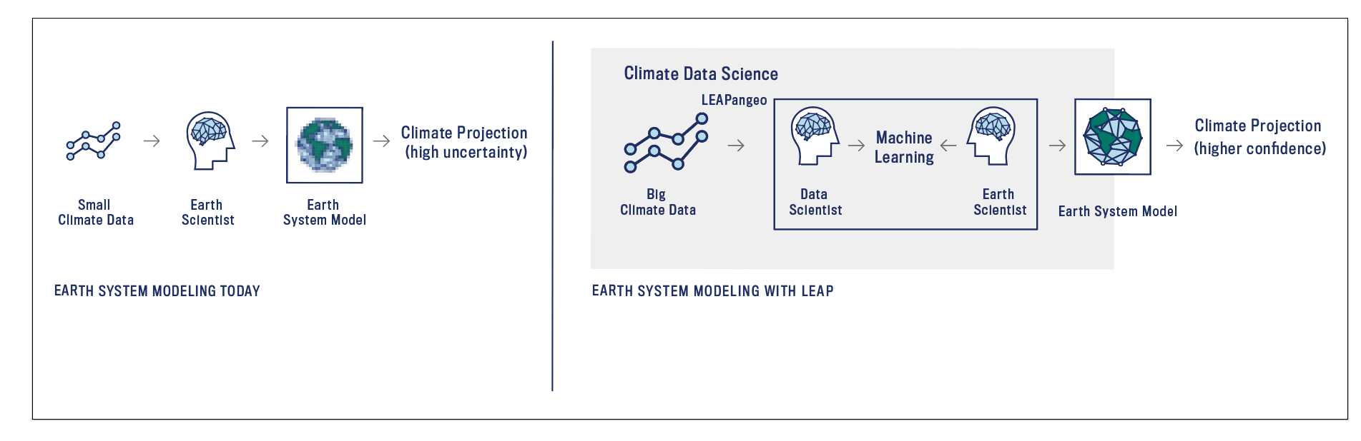
LEAP Tackles these Challenges Now
Learning the Earth with Artificial Intelligence + Physics

Slide 24
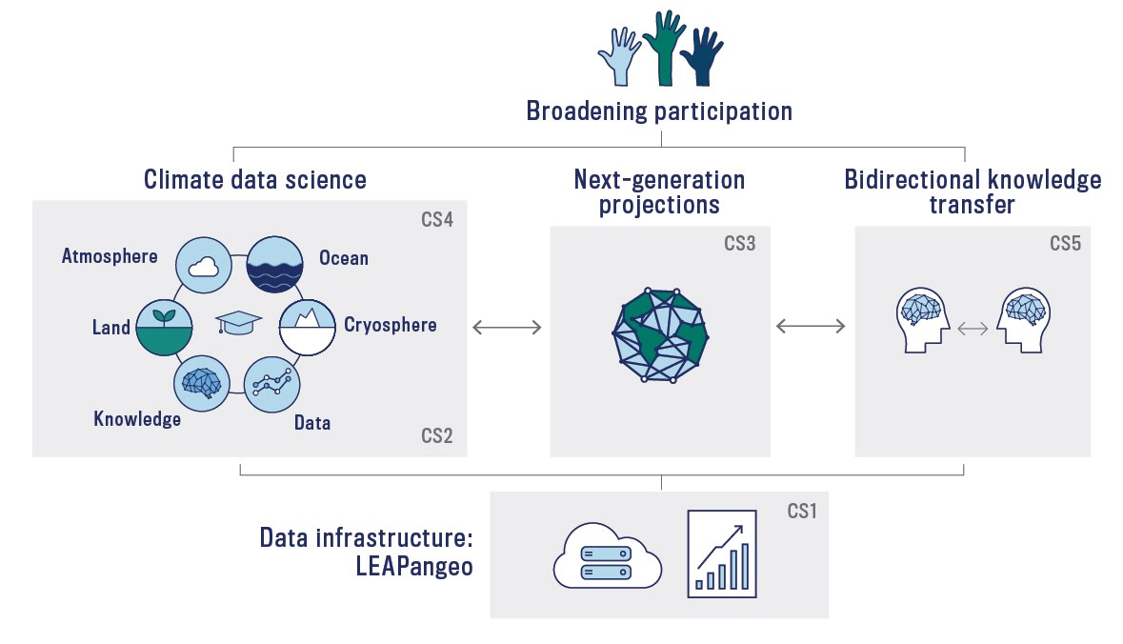
Vision: LEAP Forward in the Reliability, Utility + Reach of Climate Projections through Synergistic Innovations in Data Science + Climate Science

Slide 25
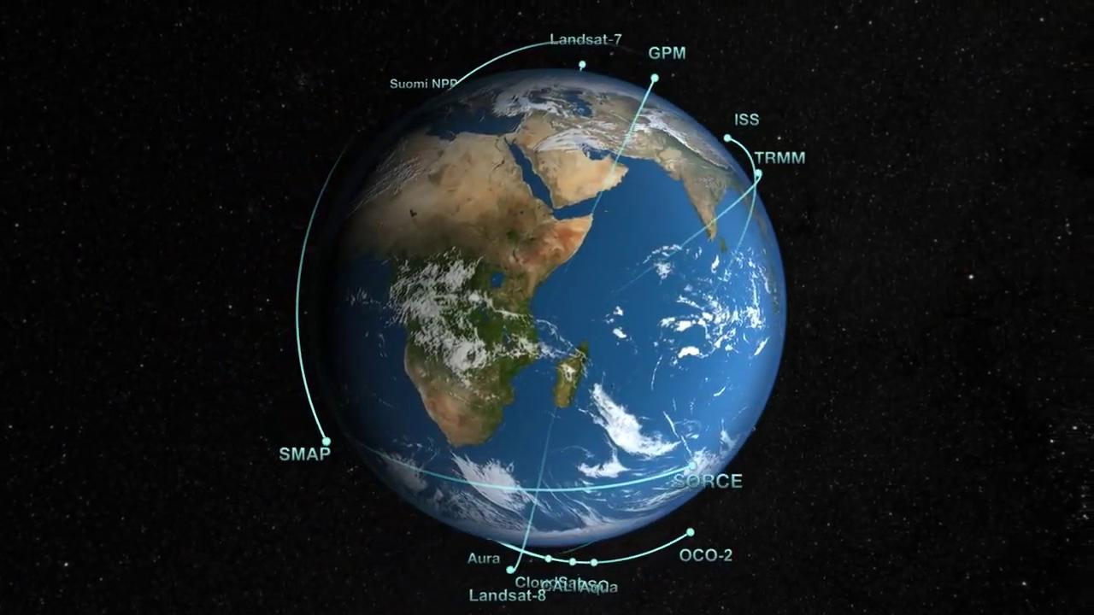
Today is a Unique Moment of Opportunity
Massive Data
from Earth Observations

Slide 26
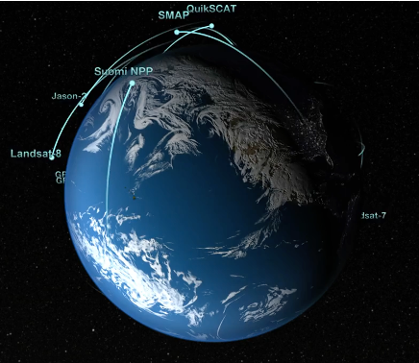
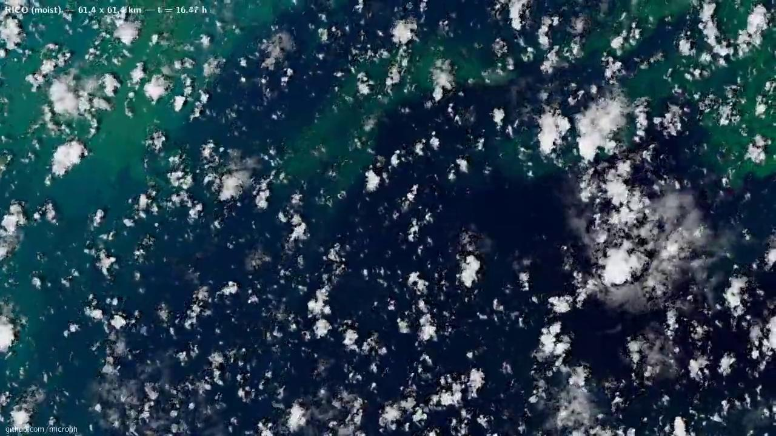
Today is a Unique Moment of Opportunity
Massive Data
from Earth Observations
High-Resolution Process-Resolving Simulations

Slide 27
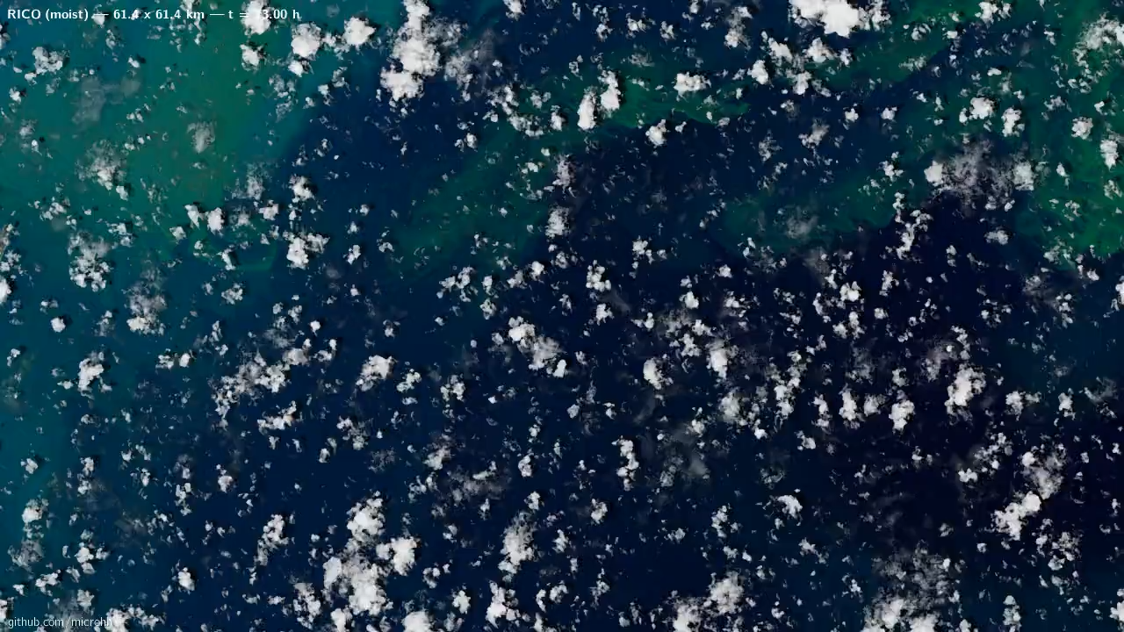

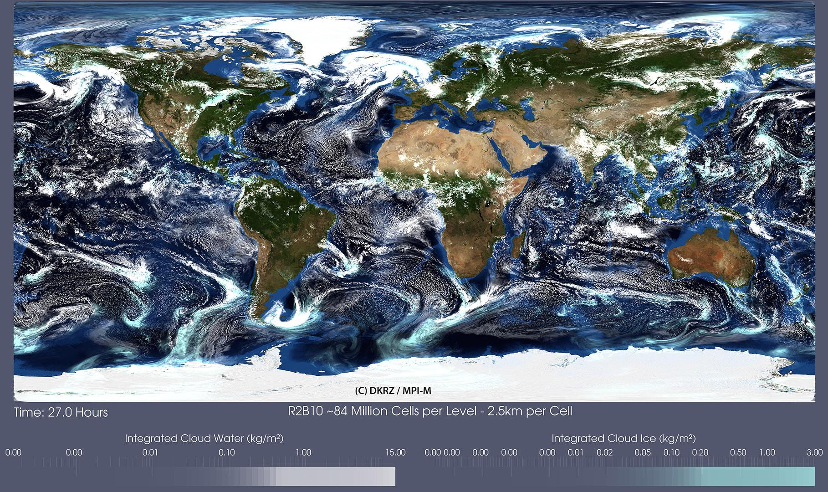
Today is a Unique Moment of Opportunity
Massive Data
from Earth Observations
High-Resolution Process-Resolving Simulations
Progress in Machine Learning

Slide 28
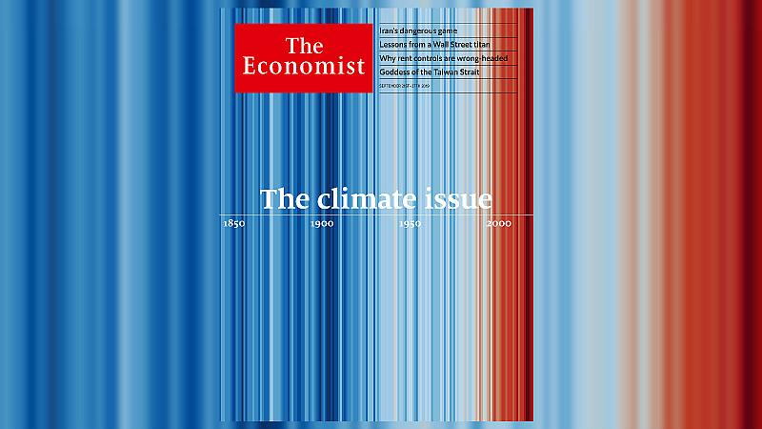
Today is a Unique Moment of Opportunity
Public Debate on Climate Change + Diversity
Massive Data
from Earth Observations
High-Resolution Process-Resolving Simulations
Progress in Machine Learning

Slide 29
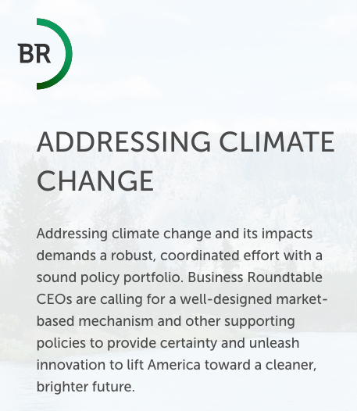
Today is a Unique Moment of Opportunity
Public Debate on Climate Change + Diversity
Massive Data
from Earth Observations
High-Resolution Process-Resolving Simulations
Progress in Machine Learning
Private Sector is New Ally for Change
Business Roundtable 9/16/20
LEAP converges + elevates these opportunities to achieve its vision.

Slide 30
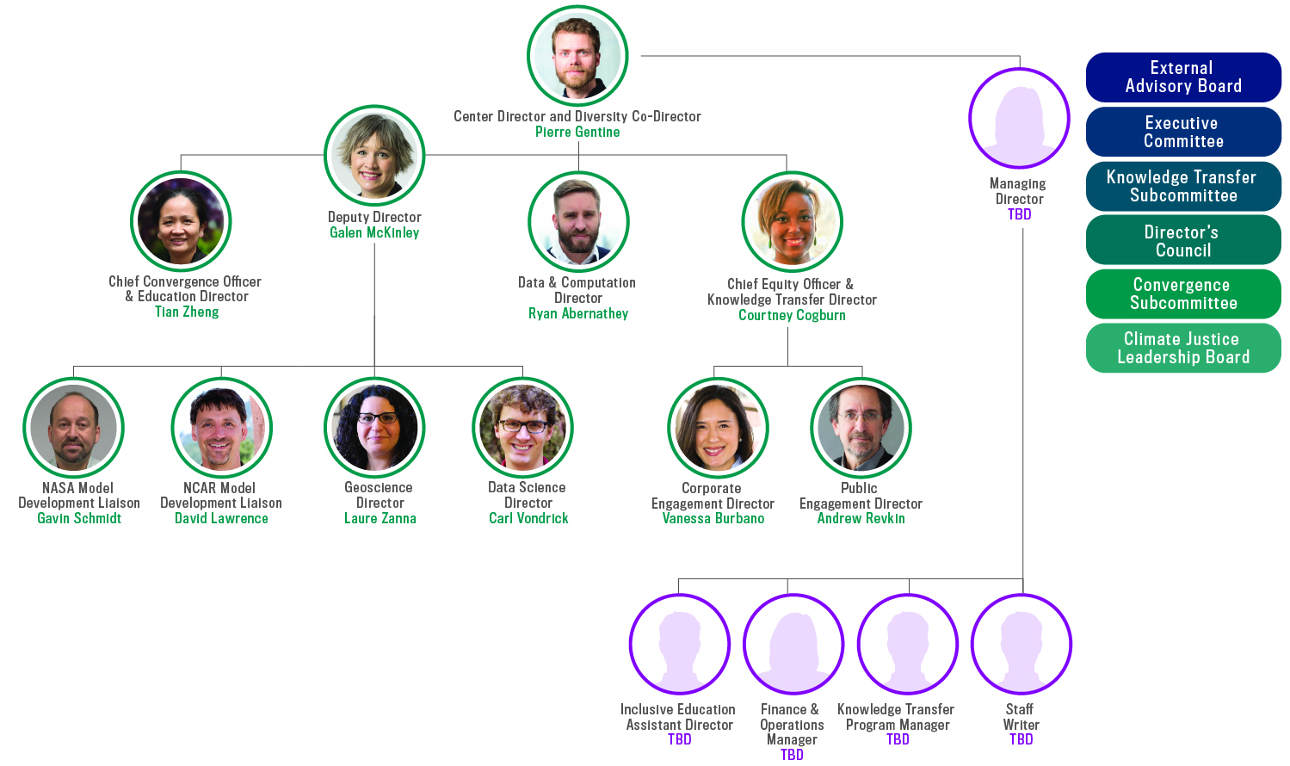
LEAP’s Vision is Achieved Through Convergence
Diverse + cohesive leadership
Highly-convergent team
  28 climate scientists
  14 data scientists
  6 social scientists
  5 administrative leaders
5 university partners
20+ non university partners
Transparent Governance Structure
  5 governance committees
  5 dedicated administrative staff

Slide 31




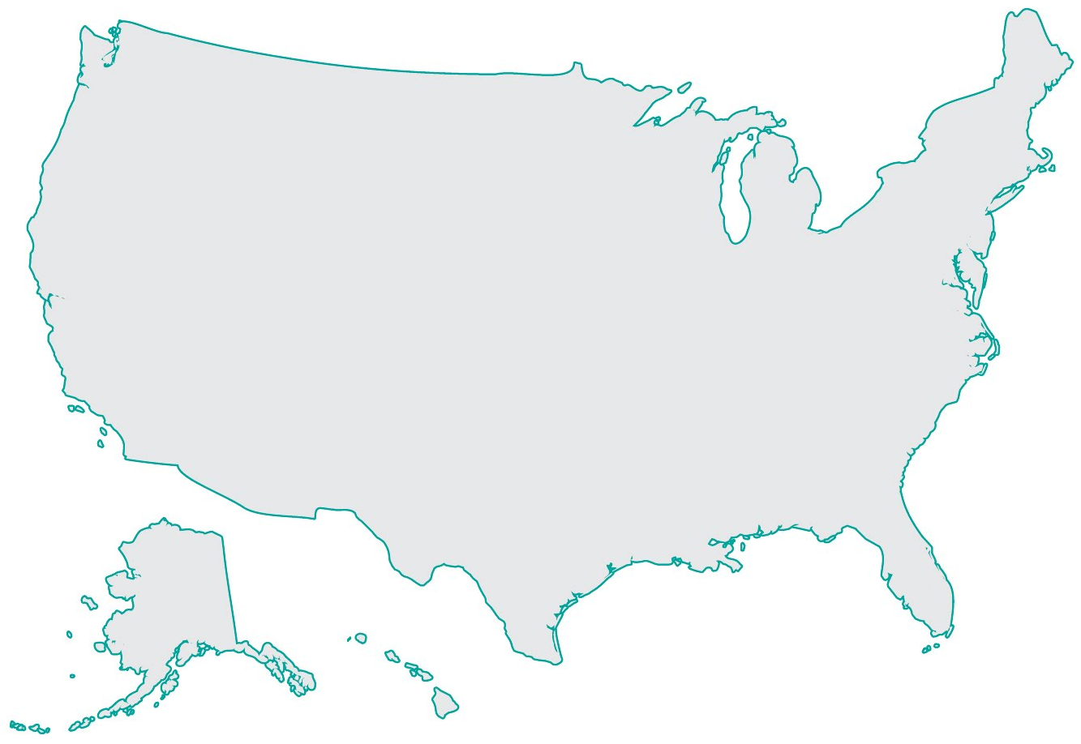

























LEAP Spans the Continent, Hubbed in NYC

Slide 32














LEAP Builds upon Innovative + Convergent Collaborations
Pioneering work on climate modeling + machine learning *
Initial Funding
NSF, NOAA, Google,
Columbia Seed Funding
Innovative education programs
Bidirectional corporate + public engagement
Add NOAA
HDR
*2018, PNAS, GRL, EECV; 2019 Nature, JAMES, Scientific Advances, PNAS, CVPR
2020 Nature Communications, JAMES, PRL (in review), Science Robotics (in review)

Slide 33
Five Convergence Strategies (CS)
Drive LEAP’s Vision
CS4: Equitably + inclusively train climate data scientists
CS2: Create next-generation algorithms
CS5: Establish bidirectional knowledge transfer
CS3: Develop
next-generation CESM
CS1: Revolutionize geoscience data infrastructure

Slide 34

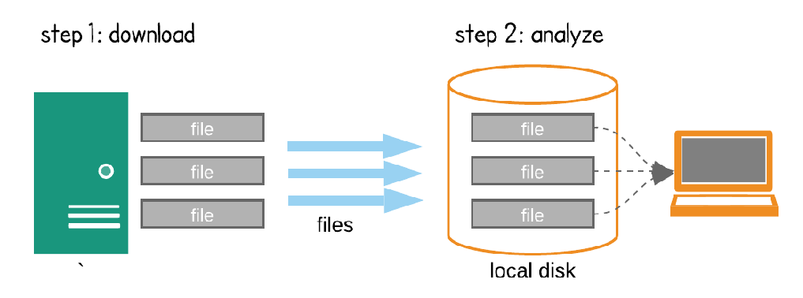
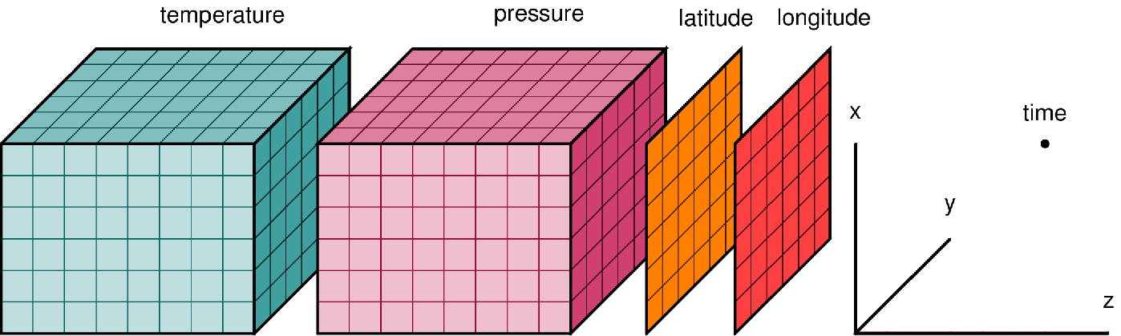



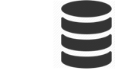

CS1: Revolutionize Geoscience Data Infrastructure
Challenge: Massive + heterogeneous datasets
Solution: LEAPangeo: open-cloud computing platform
Download Model
Data-Proximate Computing
👩🏾‍💻👨🏻‍💻👩🏽‍💻
Data Library
Compute Environment

Slide 35

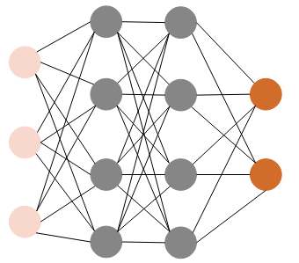


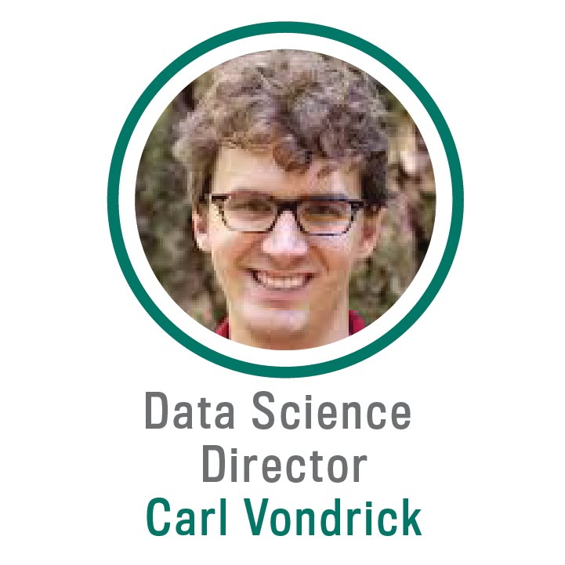

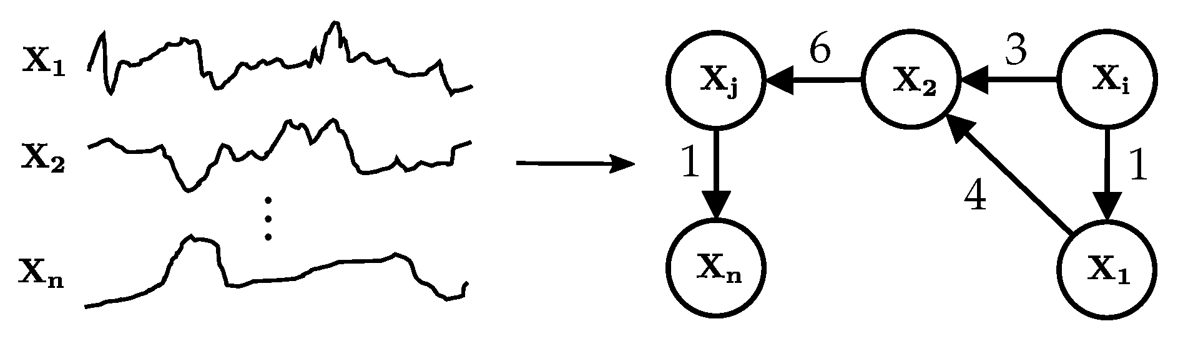
CS2: Create Next-Generation Algorithms
Challenge: ML algorithms need to respect physics + better extrapolate + be interpretable
Solution: Include physical + causal knowledge to robustly extrapolate + understand
New Algorithms
Better Extrapolation, Generalization + Interpretability

Slide 36
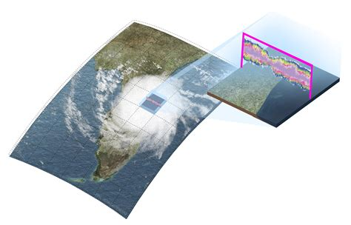


CS3: Develop Next-Generation CESM
Challenge: Create high-reliability climate projections
Solution: Harness new ML and data to transform the
open NSF-funded Community Earth System Model (CESM)
New Algorithms
New Parameterizations
Next-Generation CESM
More Accurate Projections
High-Fidelity Models
Observations

Slide 37
CS4: Equitably + Inclusively Train
Climate Data Scientists
Challenge: Distinct fields + vocabularies limit collaborations + progress
Climate Science Research
Limited
Collaboration
Data Science Research
Climate Science Skills
Data Science
Skills
Climate Science
Core Competencies
Data Science
Core Competencies
Climate Science
Literacy
Data Science
Literacy

Slide 38
CS4: Equitably + Inclusively Train
Climate Data Scientists
Challenge: Distinct fields + vocabularies limit collaborations + progress
Solution: Forge the new climate data science discipline via convergence between education + research
  Expand on major ADVANCE lessons

Slide 39

CS5: Establish Bidirectional
Knowledge Transfer
Challenge: Better climate modeling will not increase climate adaption alone
Solution: Bidirectional communication across academia, modeling centers + diverse stakeholders
  Advance climate modeling utility, reach + relevance

Slide 40
An STC is Necessary to Achieve LEAP’s Vision
Innovative + Transformative
Creating reliable climate adaptation requires:
Convergent research + education
  Defining new discipline
Equitable workforce + stakeholder engagement
Bidirectional knowledge transfer
Complex + Large-Scale
LEAP subcomponents are interdependent + interconnected
  Requires synergies impossible for smaller grants
Long-Term
LEAP needs national visibility + cohesive impact

Slide 41
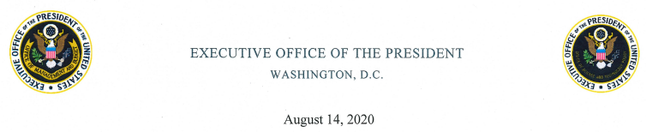
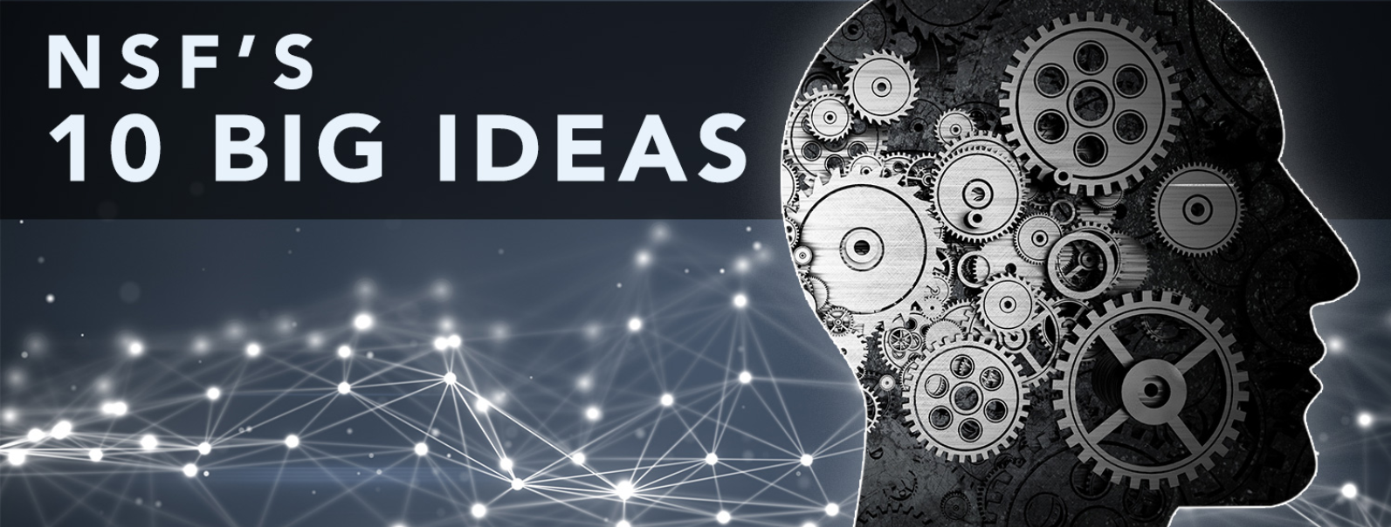
LEAP Addresses National Priorities
“Beyond healthcare, use-inspired AI research ... can help the Nation address future crises.
“Agencies should prioritize, coordinate + collaborate to... [improve] the theoretical understanding and practical utilization of [climate] predictability… + [explore] advanced modeling capabilities using non-traditional approaches such as AI.”
Harnessing the Data Revolution
Midscale Research Infrastructure
Future of Work
Navigating the New Arctic
Growing Convergence Research
INCLUDES

Slide 42
LEAP’s 5 - 10 Year Legacy will be Significant
Develop next-generation climate models with novel parameterizations
Train new generation of climate data scientists to bridge academia + society
Forge a significantly more diverse cohorts of scientists
Establish community + dialogue with heterogeneous stakeholders around actionable climate model metrics

Slide 43
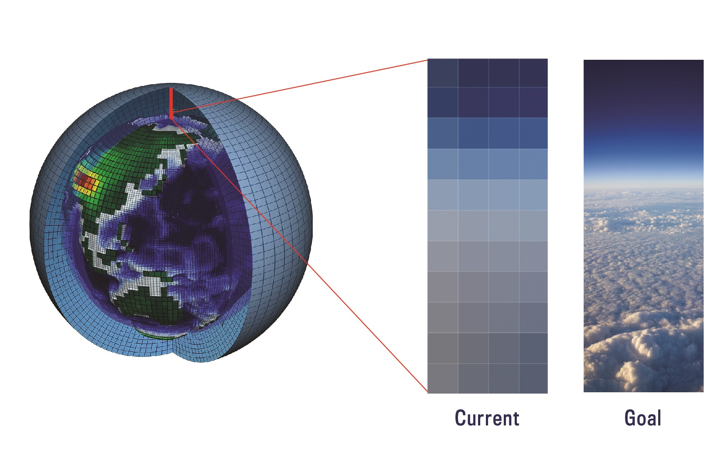
Vision: LEAP Forward in the Reliability, Utility + Reach of Climate Projections through Synergistic Innovations in Data Science + Climate Science
For climate adaptations, we pledge a LEAP in:
Reliability, by developing next-generation climate projections with data at its core.
Utility, by creating a platform for two-way interactions with the broader community.
Reach, by diversifying pipeline + reach, while training more diverse climate data scientists.
Achieved through convergence between
data science + climate science

Slide 44
Questions?

Slide 45
LEAP Can Break the Climate Reliability Deadlock
Develop next-generation parametrizations learnt from data + deeper understanding
Define better metrics to systematically evaluate + refine ESMs
LEAP forward in the reliability, utility + reach of climate projections

Slide 46
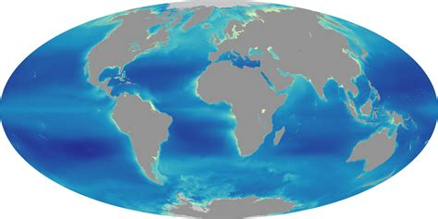
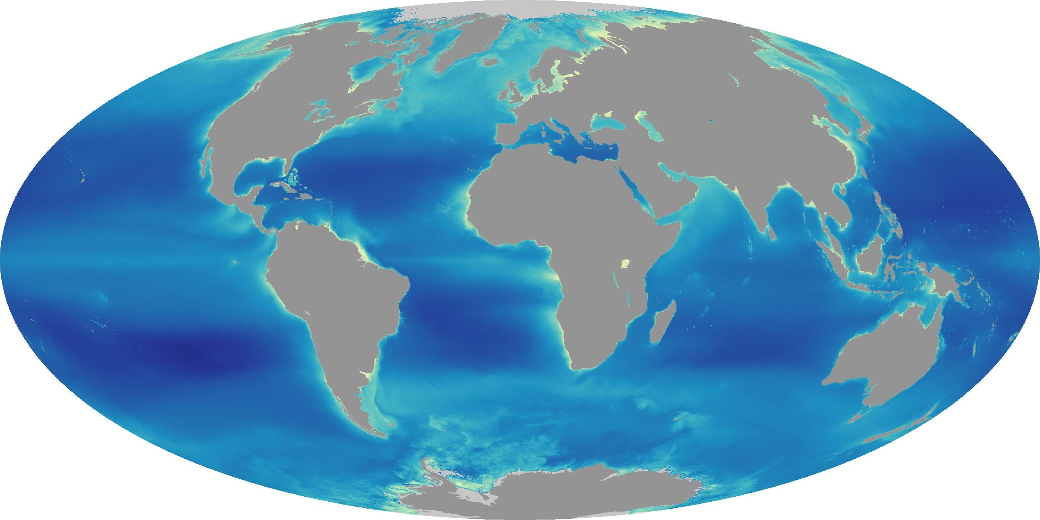
All Climate Model Components are Unreliable
Atmosphere, ocean, land, cryosphere
Ocean Heat Content (CMIP5)
Model Spread
1%CO2/year increase experiments
Newsom, Zanna et al, 2020 Geo Res Letters; Bronselaer + Zanna, 2020 Nature

Slide 47
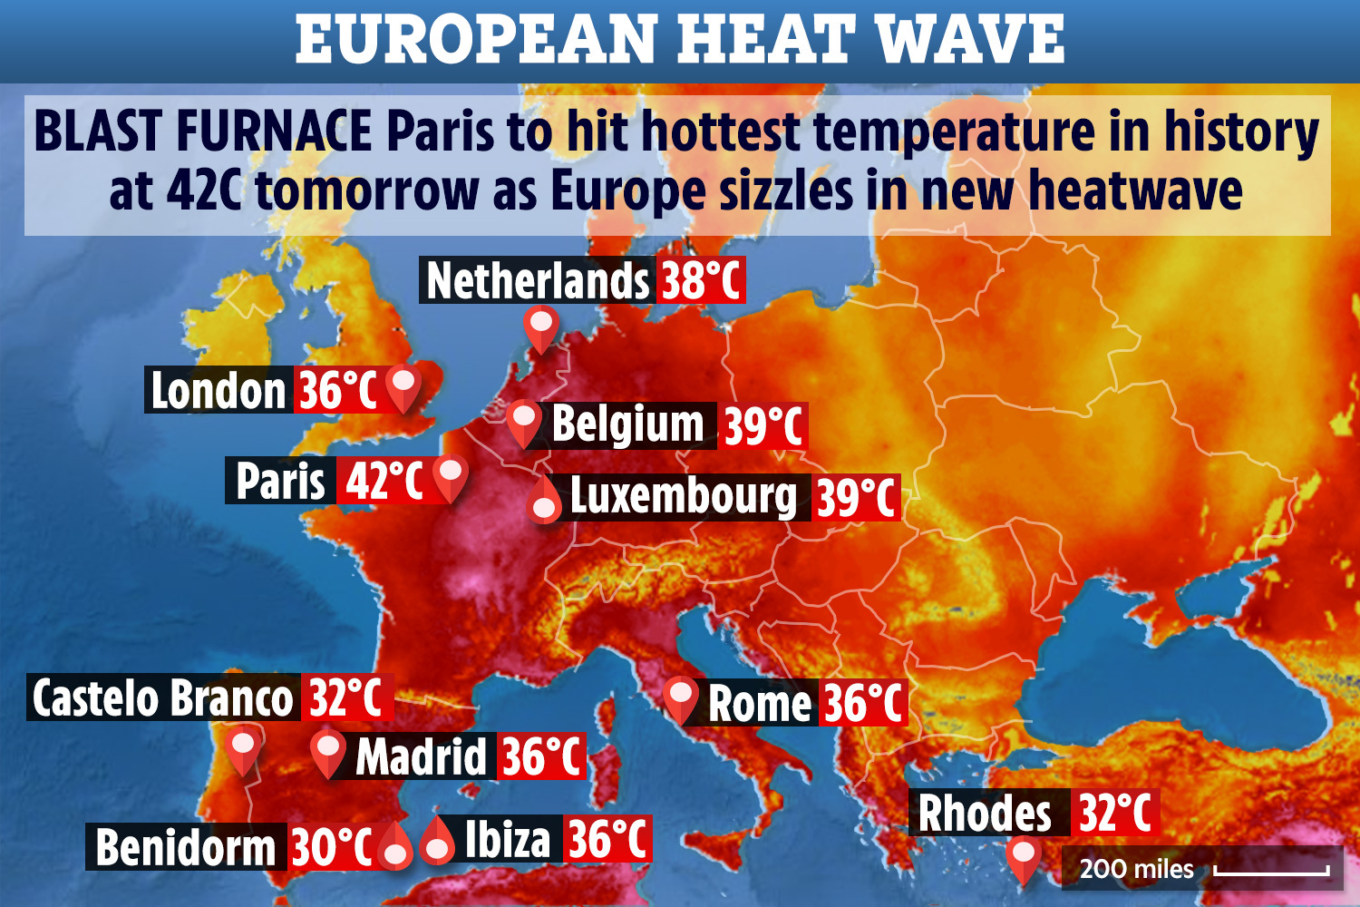
Climate Change is our Grand Challenge
Occurring now: increased intensity + frequency of extreme events
“The July 2019 heatwave was so extreme over continental Western Europe that the observed magnitudes would have been extremely unlikely without climate change.”- World Weather Attribution
World Weather Attribution

Slide 48
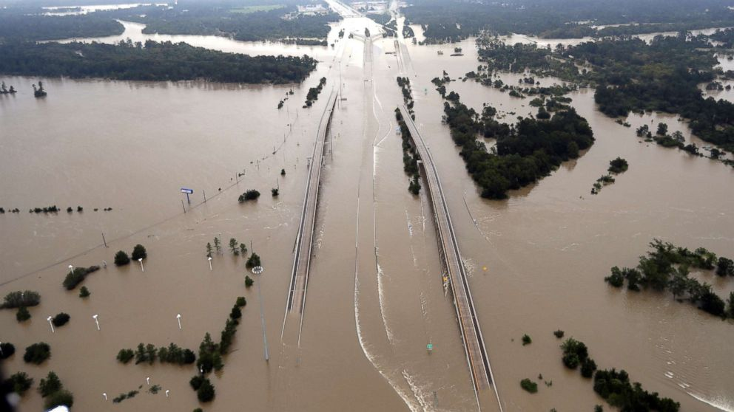

Climate Change is our Grand Challenge
Occurring now: increased intensity + frequency of extreme events
“Climate change made the record rainfall that fell over Houston during Hurricane Harvey roughly three times more likely and 15 percent more intense.” World Weather Attribution
World Weather Attribution

Slide 49


Climate Change is our Grand Challenge
Occurring now: increased intensity + frequency of extreme events
World Weather Attribution

Slide 50


All Climate Model Components are Unreliable
Atmosphere, ocean, land, cryosphere
Terrestrial Biosphere Carbon Uptake
Business as Usual Scenario
Model Spread
Friedlingstein et al. 2006 J Climate; Green, Gentine et al. 2020, Nature

Slide 51


All Climate Model Components are Unreliable
Atmosphere, ocean, land, cryosphere
Global Mean Sea Level Rise (m)
6
Business as usual Scenario
5
4
Model Spread
3
2
1
0
2000
2100
2200
2300
Year
Oppenheimer, et al. 2019, IPCC Report on the Ocean + Cryosphere in a Changing Climate

Slide 52

Regional Climate Projection is Even Less Precise
Even sign of change is unknown → limits local adaptation capacity
Model Spread
2060-2089 mean precipitation change (RCP8.5 - Business as usual)
Polade et al., 2017, Scientific Reports

Slide 53

Adaptation Requires Reliable Climate Projections (Forecasts)
Climate model uncertainties
dominate in 10-40 year projections
10-40 year timeframes most important for
investment + financing
Reliable Climate Projections Must
  Reduce Uncertainty
  Better Quantify Uncertainty
LEAP’s focus
CMIP6 (New-Generation Model Intercomparison)
Lehner et al. 2020 Earth System Dynamics; Hawkins + Sutton 2009 BAMS

Slide 54
Adaptation Requires Reliable Climate Projections (Forecasts)
Climate model uncertainties
dominate in 10-40 year projections
10-40 year timeframes most important for
investment + financing
RELIABLE Climate Projections Must
  Reduce Uncertainty
  Better Quantify Uncertainty
LEAP’s focus
CMIP6 (New-Generation Model Intercomparison)
Lehner et al. 2020 Earth System Dynamics; Hawkins + Sutton 2009 BAMS

Slide 55
Uncertainties in models and observations
Model uncertainties:
  Internal variability/stochasticity (chaotic system)
  Inadequate parameter tuning
  Structural errors (incorrect equations)
  Initial conditions (data assimilation)
Observational uncertainties:
  Observational noise (e.g. satellite)
  Indirect estimate (e.g. radiative transfer model)
  Stochasticity/randomness

Slide 56
LEAP is Distinct From but Synergistic With Others
Similar Efforts | How LEAP is Distinct
CLIMA | LEAP goes beyond model parameter uncertainty quantification: LEAP addresses model structural deficiencies + metrics with next-generation machine learning for all model components, on open platform
NSF AI Institute: Artificial Intelligence for Environmental Sciences | AI Institute focused on weather extremes detection not on climate (>1 year) modeling. Highly synergistic + will highly benefit from LEAP
Vulcan | LEAP tackles all Earth system components (not just convection/ atmosphere) + multi-decadal climate projections

